Slide 1
Data Science for the Rest of Us Brandon Rohrer, Senior Data Scientist Welcome to the webinar! We’ll start in a minute.

Slide 2
If you…
are wondering whether to hire a data scientist,
are thinking about becoming a data scientist,
want to surprise and impress your data scientist co-workers,
have a loved one that is a data scientist,
… I wrote this presentation for you.

Slide 3

TL;DR
Data science isn’t magic,
but there are tricks
and secrets.
Notes:
You

Slide 4
You can’t use just any data.

Slide 5
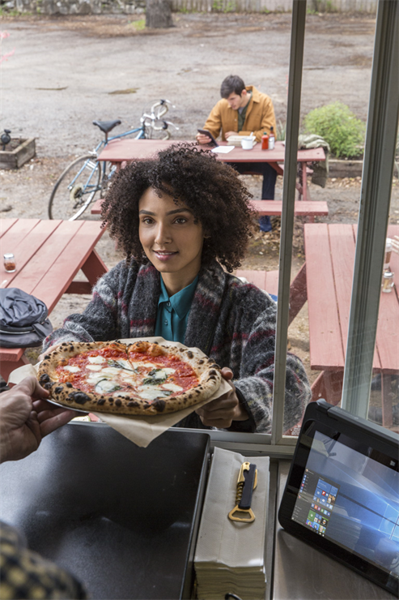
Recipe
Crispy crust
Marinara sauce
Fresh mozzarella
Thick cut pepperoni
Fresh tomato

Slide 6
Recipe
Data that is
Relevant
Connected
Accurate
Enough
and a Sharp Question

Slide 7
Irrelevant data Relevant data
Price of milk ($/gal) | Red Sox batting avg. | Blood alcohol content (%)
3.79 | .304 | .03
3.45 | .320 | .09
4.06 | .259 | .01
3.89 | .298 | .05
4.12 | .332 | .13
3.92 | .270 | .06
3.23 | .294 | .10
Body mass (kg) | Margaritas | Blood alcohol content (%)
103 | 3 | .03
67 | 5 | .09
87 | 1 | .01
52 | 2 | .05
73 | 5 | .13
79 | 3 | .06
110 | 7 | .10
[data points] [rows] [samples] [features] [columns] [attributes] [table] [database]
Notes:
Ingredient 1
Nuts

Slide 8
Irrelevant data Relevant data
Price of milk ($/gal) | Red Sox batting avg. | Blood alcohol content (%)
3.79 | .304 | .03
3.45 | .320 | .09
4.06 | .259 | .01
3.89 | .298 | .05
4.12 | .332 | .13
3.92 | .270 | .06
3.23 | .294 | .10
Body mass (kg) | Margaritas | Blood alcohol content (%)
103 | 3 | .03
67 | 5 | .09
87 | 1 | .01
52 | 2 | .05
73 | 5 | .13
79 | 3 | .06
110 | 7 | .10
[data points] [rows] [samples] [features] [columns] [attributes] [table] [database]
Notes:
Ingredient 1
Nuts

Slide 9
Irrelevant data Relevant data
Price of milk ($/gal) | Red Sox batting avg. | Blood alcohol content (%)
3.79 | .304 | .03
3.45 | .320 | .09
4.06 | .259 | .01
3.89 | .298 | .05
4.12 | .332 | .13
3.92 | .270 | .06
3.23 | .294 | .10
Body mass (kg) | Margaritas | Blood alcohol content (%)
103 | 3 | .03
67 | 5 | .09
87 | 1 | .01
52 | 2 | .05
73 | 5 | .13
79 | 3 | .06
110 | 7 | .10
[data points] [rows] [samples] [features] [columns] [attributes] [table] [database]
Notes:
Ingredient 1
Nuts

Slide 10
Disconnected data Connected data
Price of milk ($/gal) | Red Sox batting avg. | Blood alcohol content (%)
3.79 | .304 | .03
3.45 | .320 | .09
4.06 | .259 | .01
3.89 | .298 | .05
4.12 | .332 | .13
3.92 | .270 | .06
3.23 | .294 | .10
Grill temperature (F) | Weight of beef patty (lb) | Burger rating (out of 10)
 | .33 | 8.2
 | .24 | 5.6
550 |  | 7.8
725 | .45 | 9.4
600 |  | 8.2
625 |  | 6.8
 | .49 | 4.2
Grill temperature (F) | Weight of beef patty (lb) | Burger rating (out of 10)
575 | .33 | 8.2
550 | .24 | 5.6
550 | .69 | 7.8
725 | .45 | 9.4
600 | .57 | 8.2
625 | .36 | 6.8
550 | .49 | 4.2
[missing values]
Notes:
Ingredient 2
bananas

Slide 11
Disconnected data Connected data
Price of milk ($/gal) | Red Sox batting avg. | Blood alcohol content (%)
3.79 | .304 | .03
3.45 | .320 | .09
4.06 | .259 | .01
3.89 | .298 | .05
4.12 | .332 | .13
3.92 | .270 | .06
3.23 | .294 | .10
Grill temperature (F) | Weight of beef patty (lb) | Burger rating (out of 10)
 | .33 | 8.2
 | .24 | 5.6
550 |  | 7.8
725 | .45 | 9.4
600 |  | 8.2
625 |  | 6.8
 | .49 | 4.2
Grill temperature (F) | Weight of beef patty (lb) | Burger rating (out of 10)
575 | .33 | 8.2
550 | .24 | 5.6
550 | .69 | 7.8
725 | .45 | 9.4
600 | .57 | 8.2
625 | .36 | 6.8
550 | .49 | 4.2
[missing values]
Notes:
Ingredient 2
bananas

Slide 12
Inaccurate data Accurate data
[precision] [accuracy] [bias]
Notes:
Ingredient 3 caramel

Slide 13
Inaccurate data Accurate data
Notes:
Ingredient 3 caramel

Slide 14
Inaccurate data Accurate data
Notes:
Ingredient 3 caramel

Slide 15
Inaccurate data Accurate data
Notes:
Ingredient 3 caramel

Slide 16

Not enough data
Notes:
Ingredient 4
Ice cream

Slide 17

Barely enough data

Slide 18

Enough data

Slide 19
Vague questions vs. Sharp questions
Can’t be answered with a name or a number
What can my data tell me about my business?
What should I do?
How can I increase my profits?
Can be answered with a name or a number.
How many Model Q Gizmos will I sell in Montreal during the third quarter?
Which car in my fleet is going to fail first?
Notes:
Data is numbers and names
Ask a question that can be answered with a number or a name

Slide 20
Turn your data into a picture.

Slide 21
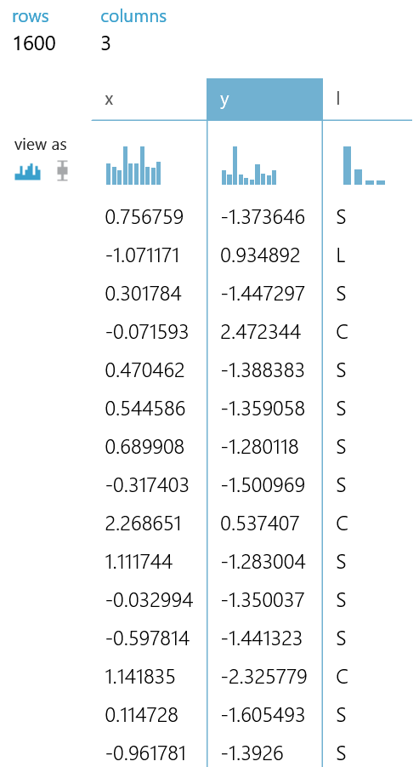
Mystery data
Two features
Four classes
1600 data points
[feature] [class] [histogram] [visualization]

Slide 22
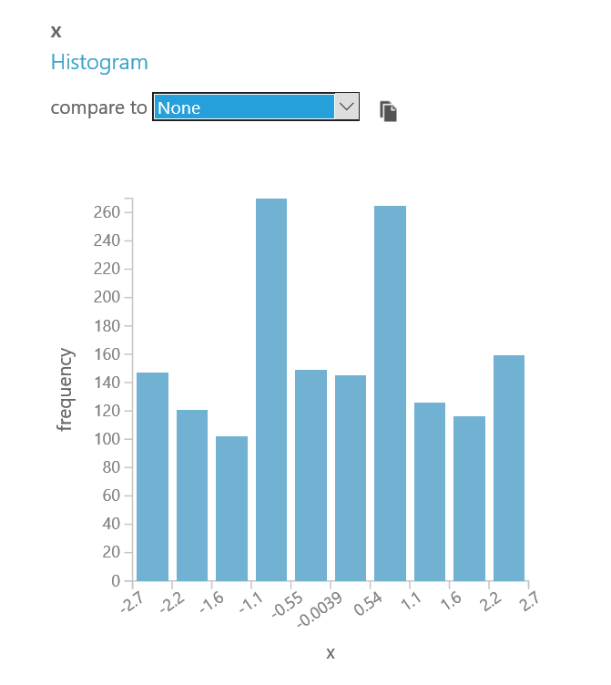
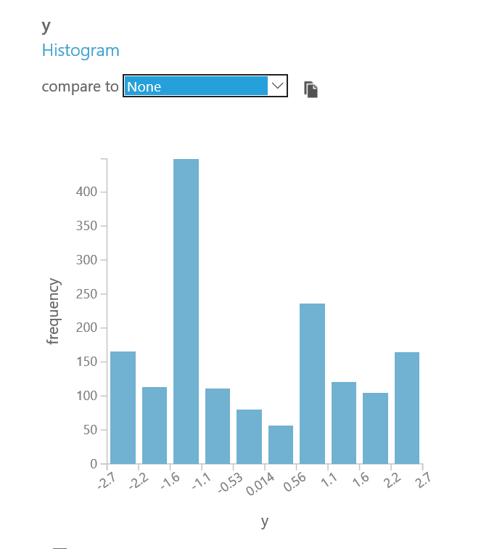
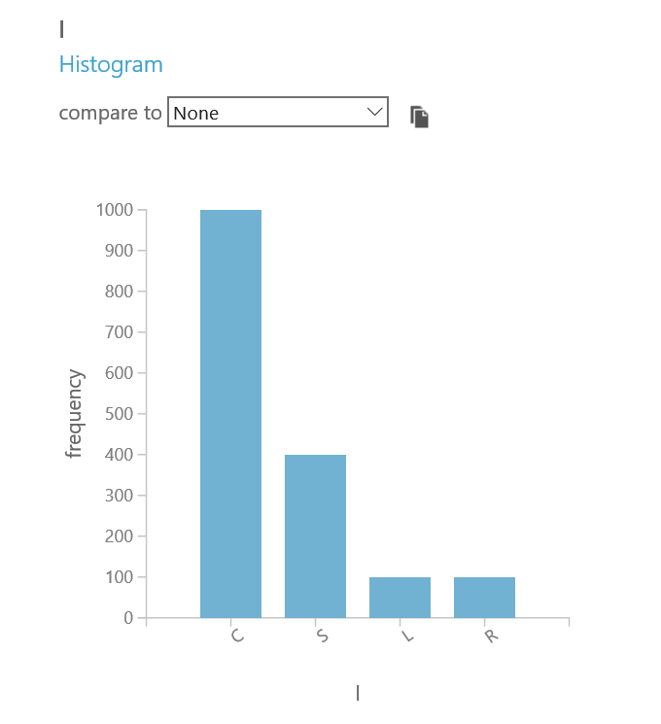

Slide 23
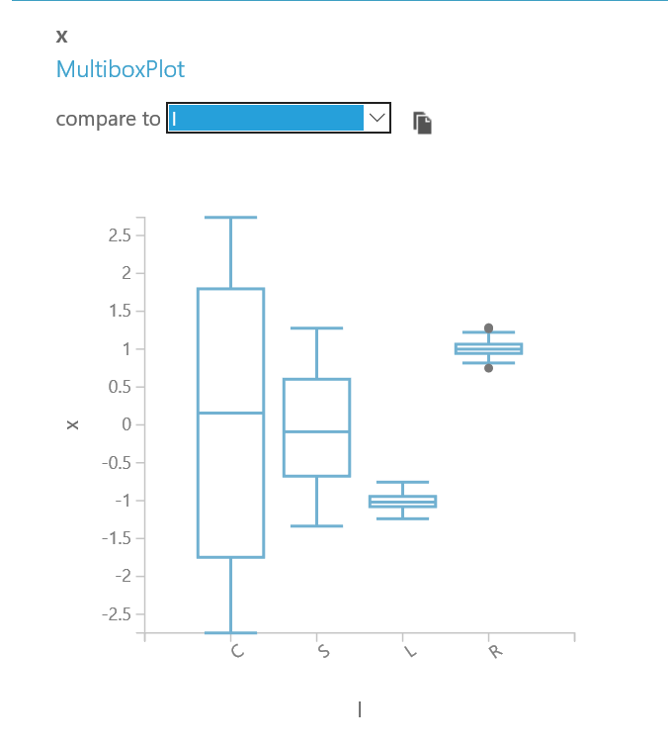
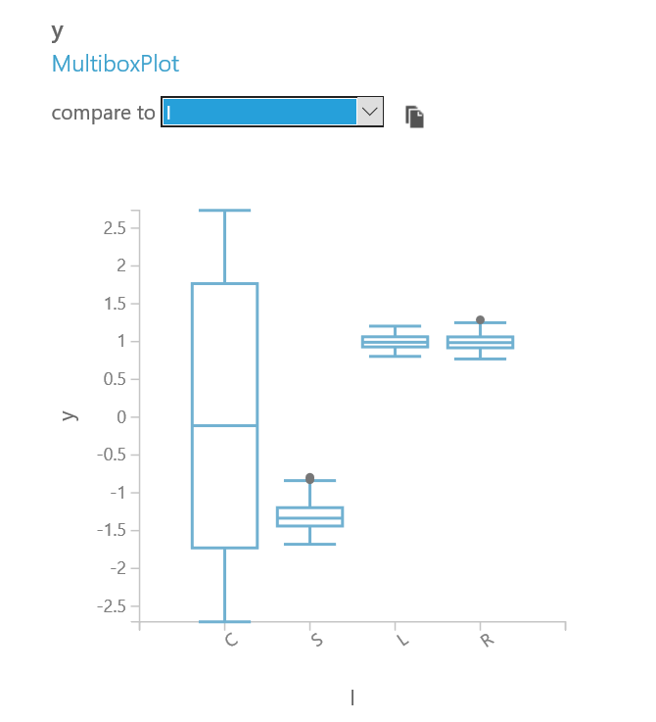

Slide 24
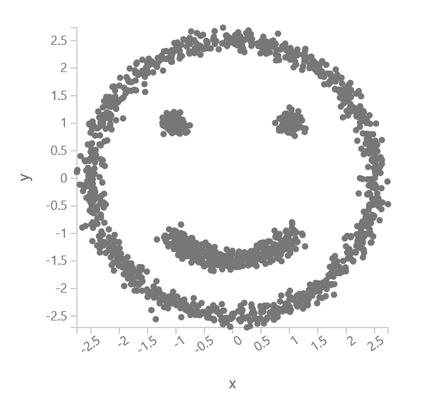

Slide 25
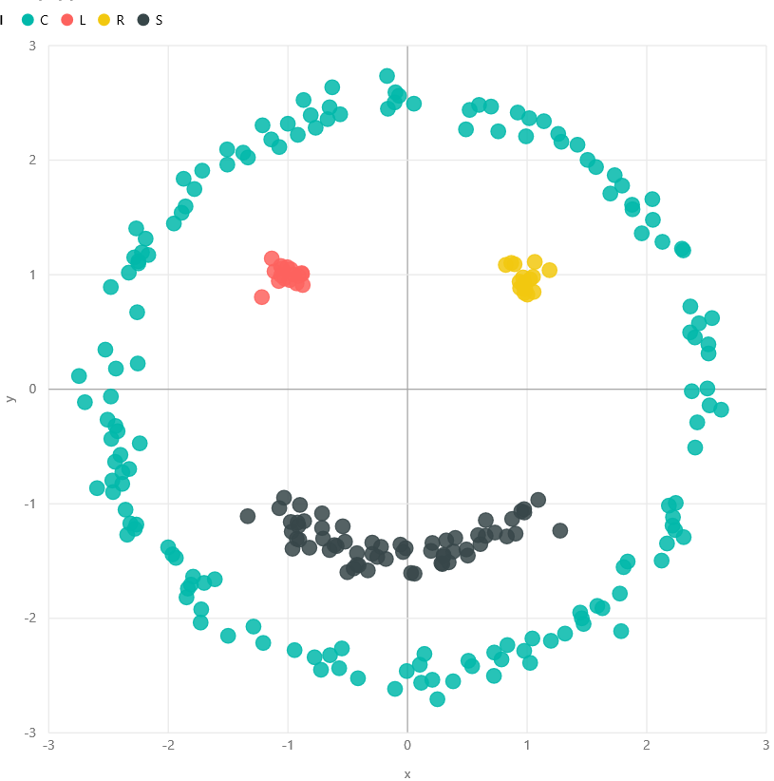

Slide 27
Data science can only answer five questions.

Slide 28
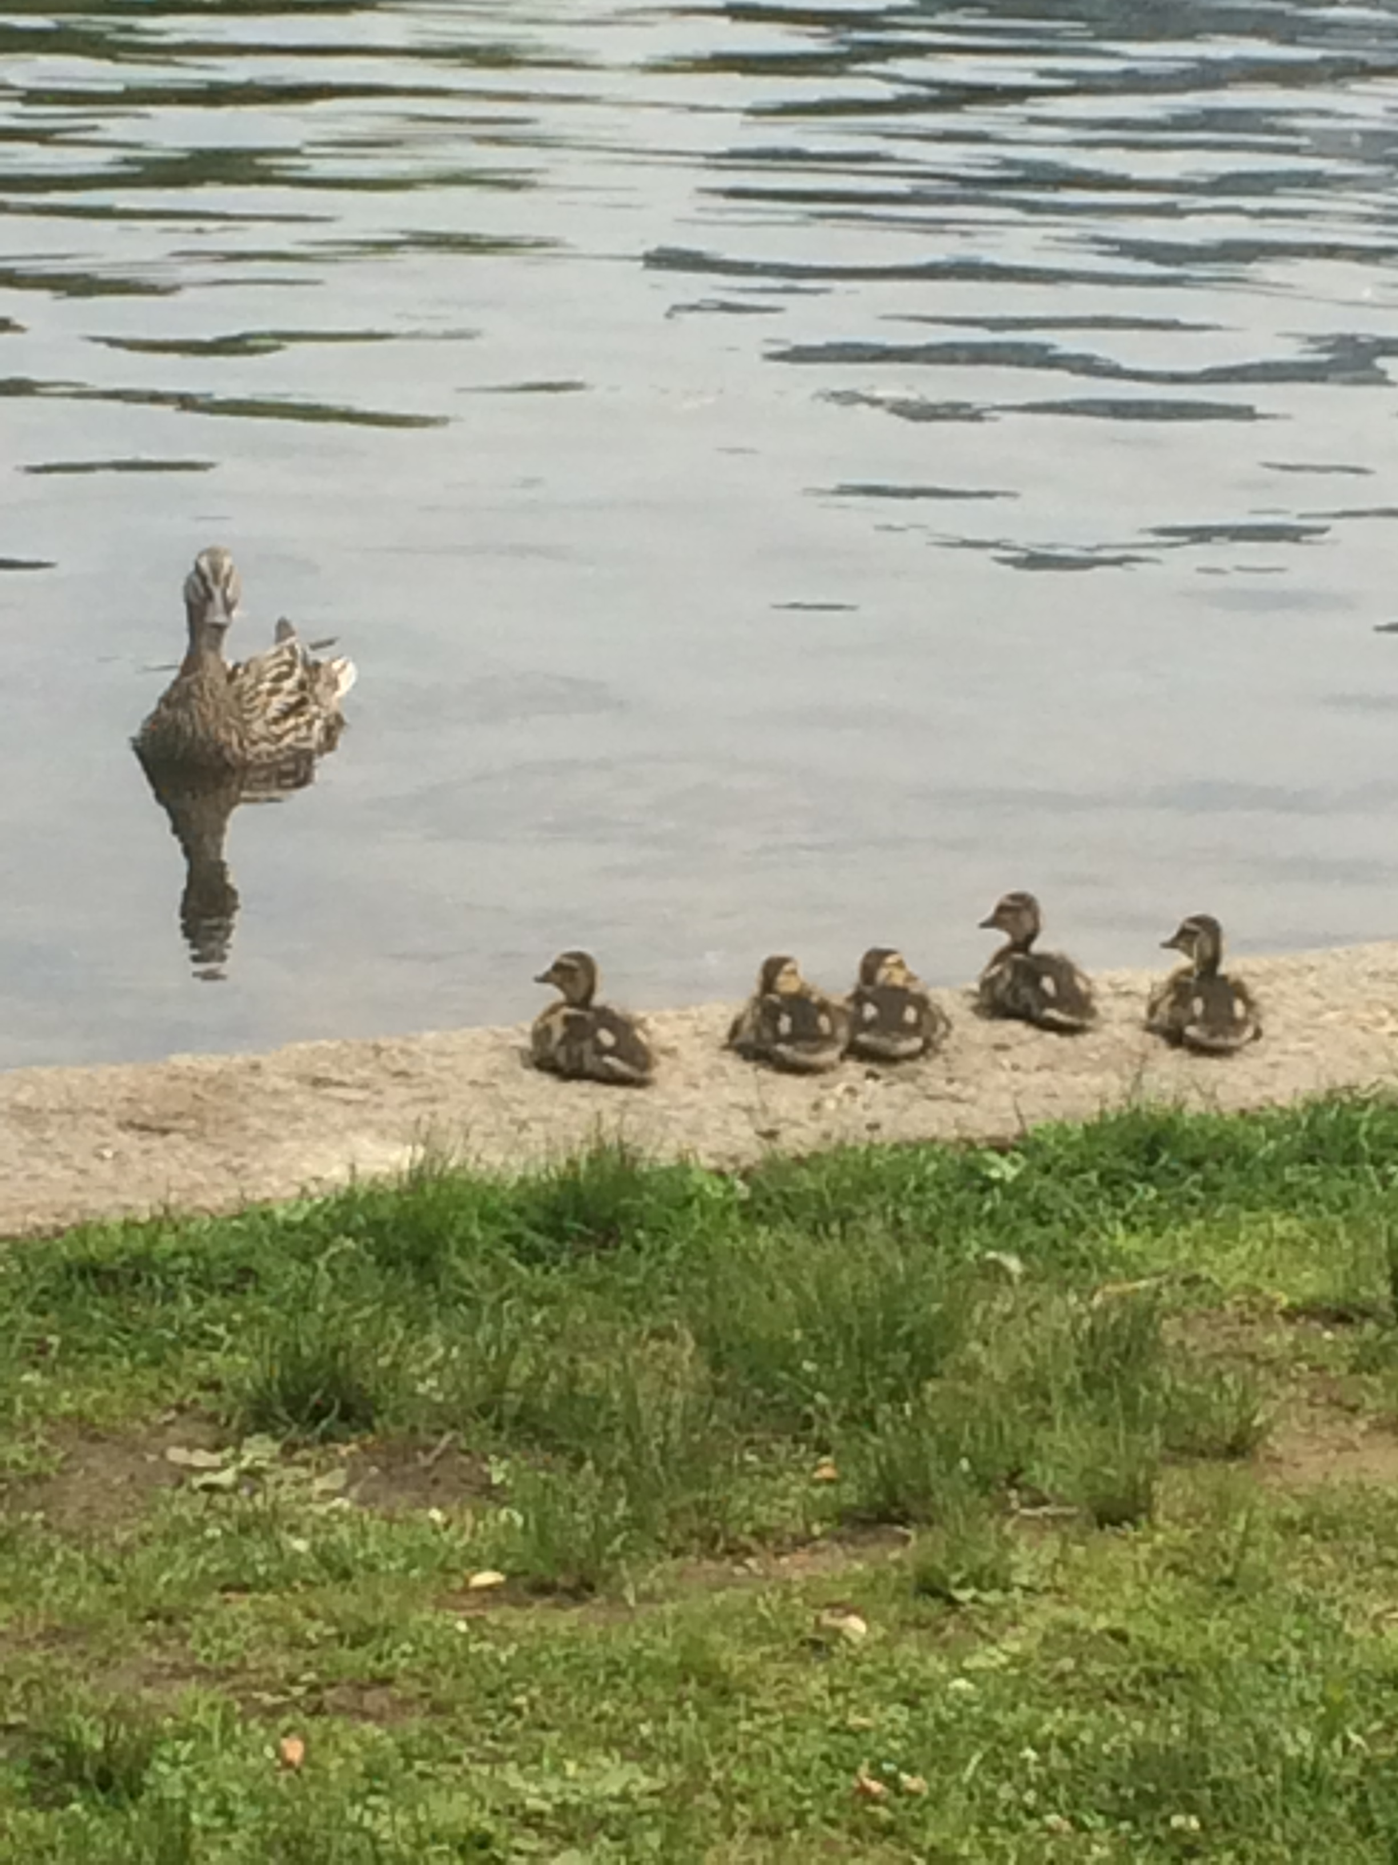
1. How much / how many?
2. Which category?
3. Which groups?
4. Is it weird?
5. Which action?
[algorithm]
Notes:
Good news: Most business and technical questions can be framed as one of these.
The answer is a name or a number.

Slide 29
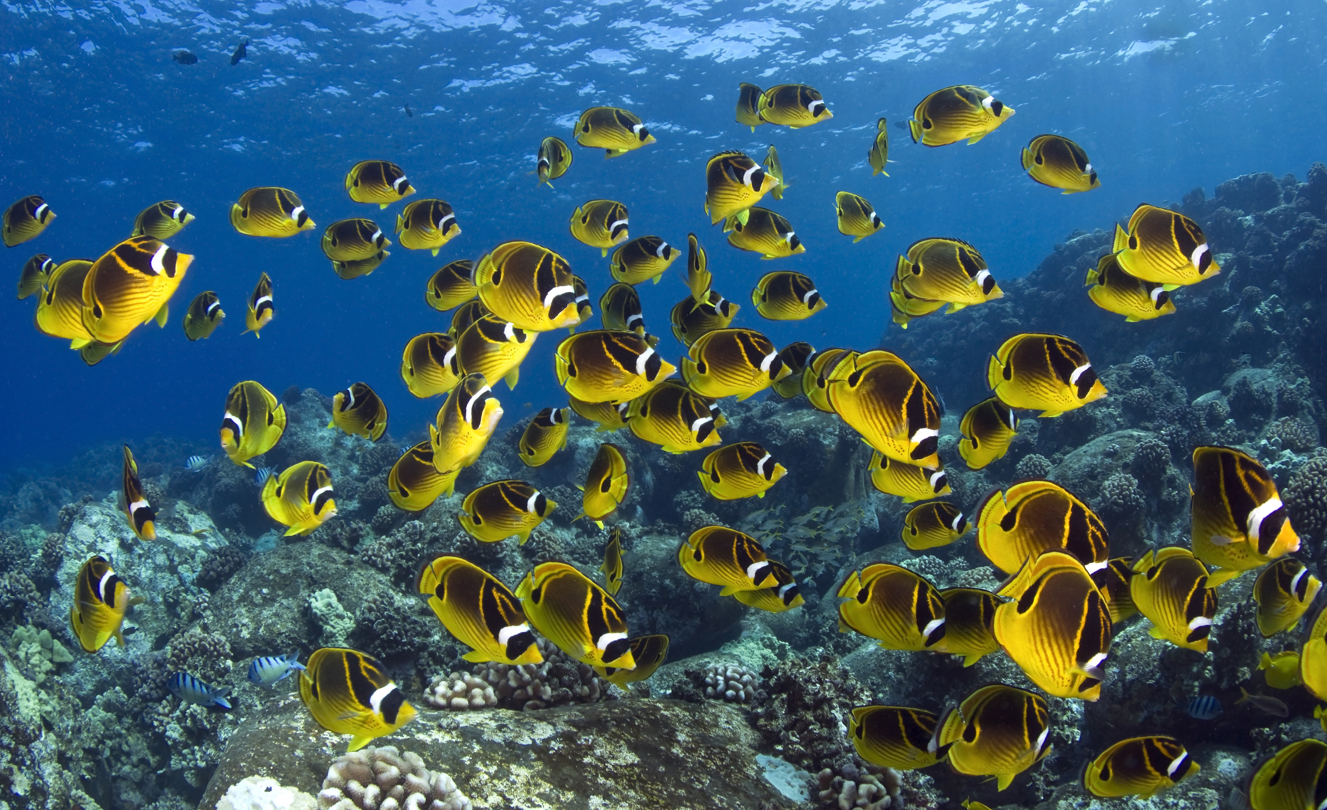
How much / how many?
What will the temperature be next Tuesday?
What will my fourth quarter sales in Portugal be?
How many new followers will I get next week?
[regression]
Notes:
Examples positive and negative

Slide 30

Which category?
Is this an image of a cat or a dog?
Which aircraft is causing this radar signature?
What is the topic of this news article?
[classification]
Notes:
Examples positive and negative

Slide 31
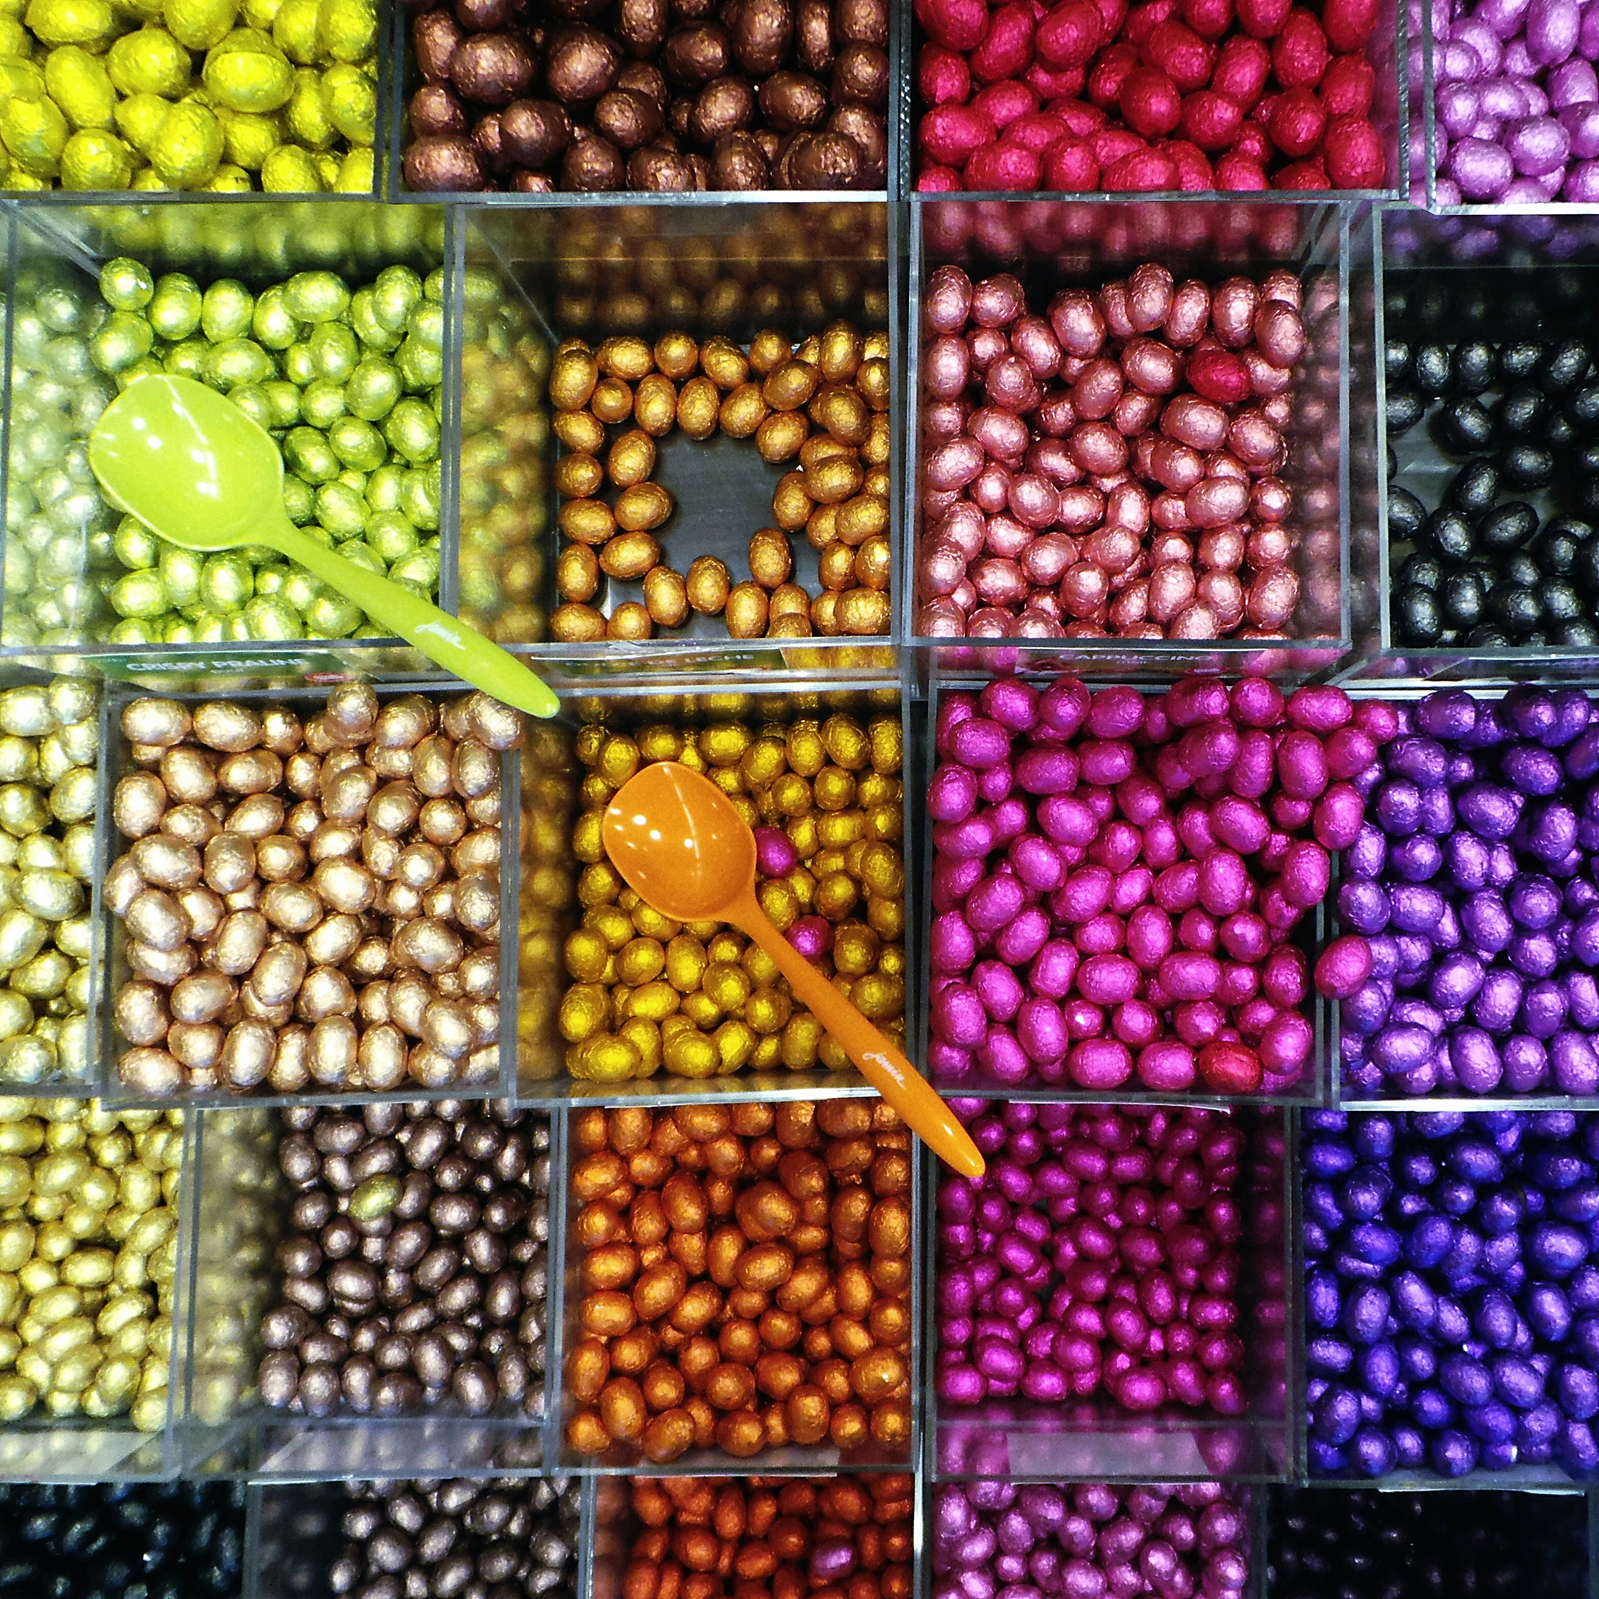
Which groups?
Which shoppers have similar tastes in produce?
Which viewers like the same kind of movies?
What is a natural way to break these documents into five topic groups?
[clustering] [recommendation]
Notes:
Examples positive and negative

Slide 32

Is this weird?
Is this pressure reading unusual?
Is this internet message typical?
Is this combination of purchases very different from what this customer has made in the past?
[anomaly detection]
Notes:
Examples—positive and negative

Slide 33

Which action?
Should I raise or lower the temperature?
Should I vacuum the living room again or stay plugged in to my charging station?
Should I brake or accelerate in response to that yellow light?
[reinforcement learning]
Notes:
Examples positive and negative

Slide 34
Machine learning is simple.

Slide 35
Машинное
обучение
не действительно
сложной,
но
oнo
иностранный
язык.
Notes:
Data scientists and tech companies benefit from the idea that machine learning is magic. It isn’t. It is subtle and powerful, but not mystical.
It’s just a foreign language

Slide 36
Machine
learning
isn’t actually
complicated,
but
it is
a foreign
language.
Notes:
Data scientists and tech companies benefit from the idea that machine learning is magic. It isn’t. It is subtle and powerful, but not mystical.
It’s just a foreign language

Slide 37
Machine
learning
isn’t actually
complicated,
but
it is
a foreign
language.
Машинное
обучение
не действительно
сложной,
но
oнo
иностранный
язык.
Notes:
Data scientists and tech companies benefit from the idea that machine learning is magic. It isn’t. It is subtle and powerful, but not mystical.
It’s just a foreign language

Slide 38
language
язык
Notes:
Data scientists and tech companies benefit from the idea that machine learning is magic. It isn’t. It is subtle and powerful, but not mystical.
It’s just a foreign language

Slide 39
язык
yazeek
Notes:
Data scientists and tech companies benefit from the idea that machine learning is magic. It isn’t. It is subtle and powerful, but not mystical.
It’s just a foreign language

Slide 40
я з ы к
ya z ee k
Notes:
Data scientists and tech companies benefit from the idea that machine learning is magic. It isn’t. It is subtle and powerful, but not mystical.
It’s just a foreign language

Slide 41
я
ya
Notes:
Data scientists and tech companies benefit from the idea that machine learning is magic. It isn’t. It is subtle and powerful, but not mystical.
It’s just a foreign language

Slide 42
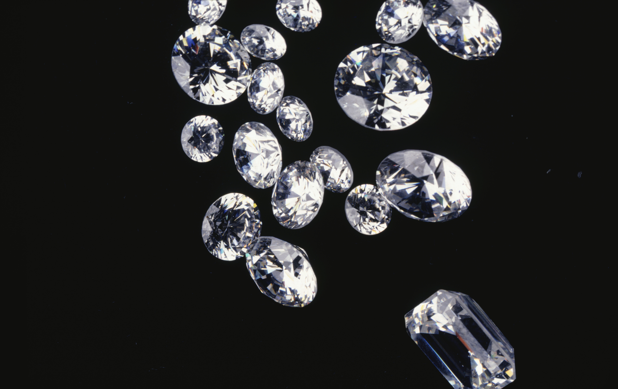
Diamonds
Notes:
Raw values

Slide 43
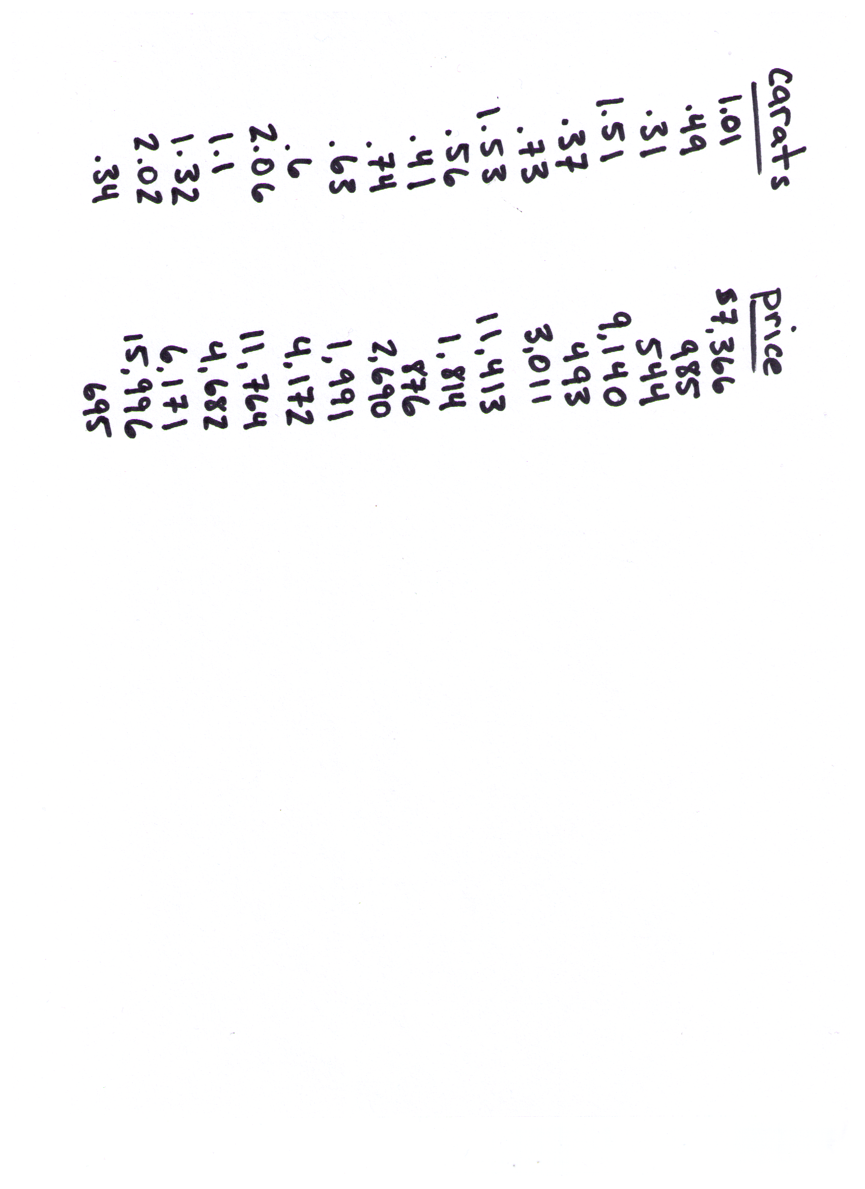

Diamonds
Notes:
Raw values

Slide 44
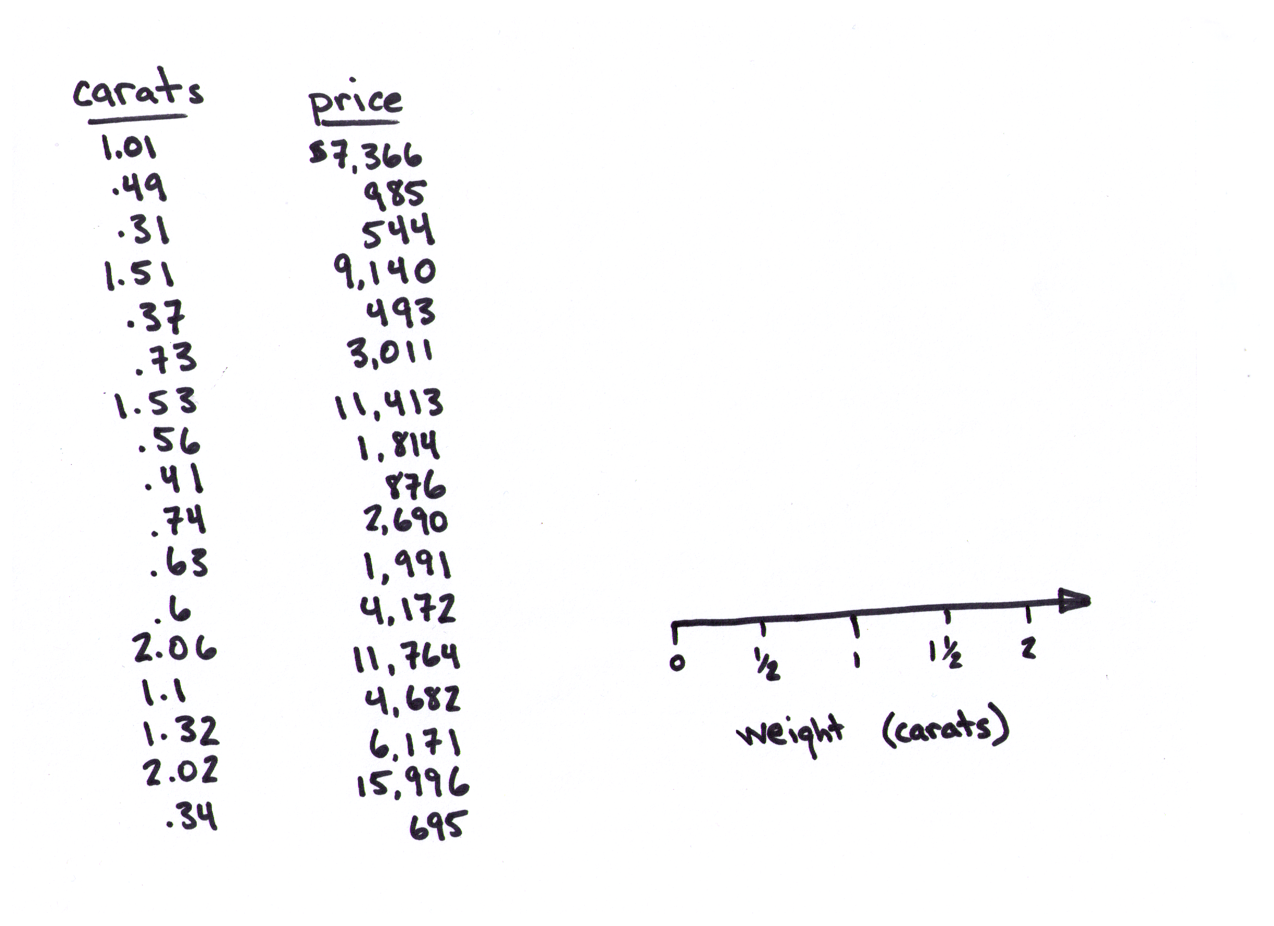
Diamonds
[number line]
[axis]
Notes:
Raw values

Slide 45
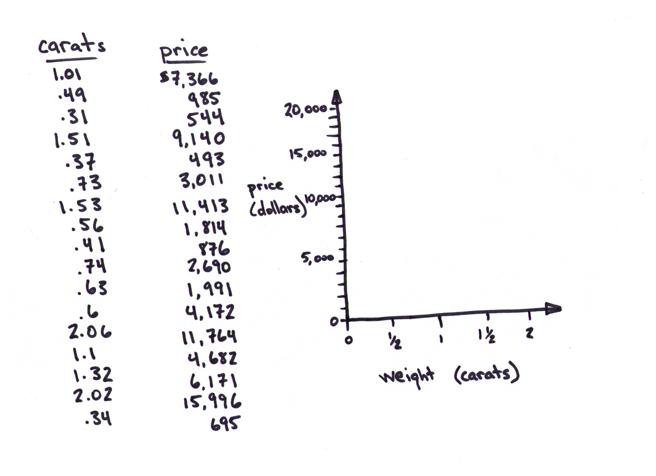
Diamonds
[axes]
[units]
Notes:
Raw values

Slide 46
Diamonds
Notes:
Raw values

Slide 47
Diamonds
Notes:
Raw values

Slide 48
Diamonds
Notes:
Raw values

Slide 49
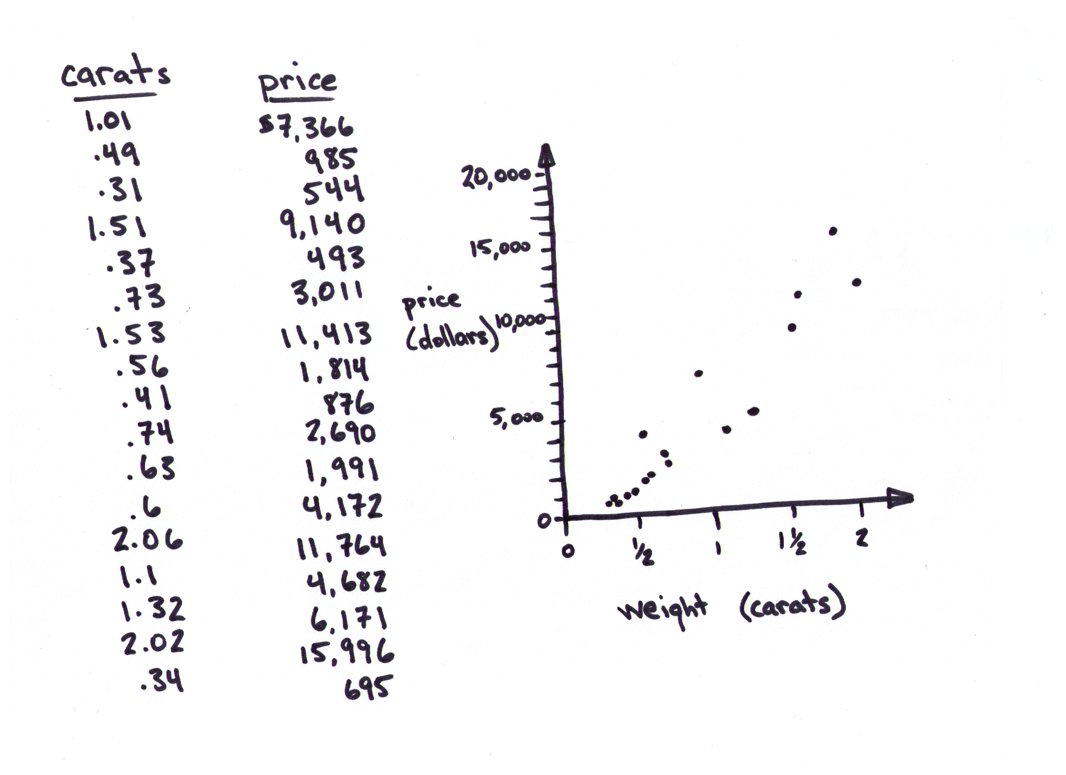
Diamonds
[plot]
[scatter plot]
Notes:
Raw values

Slide 50
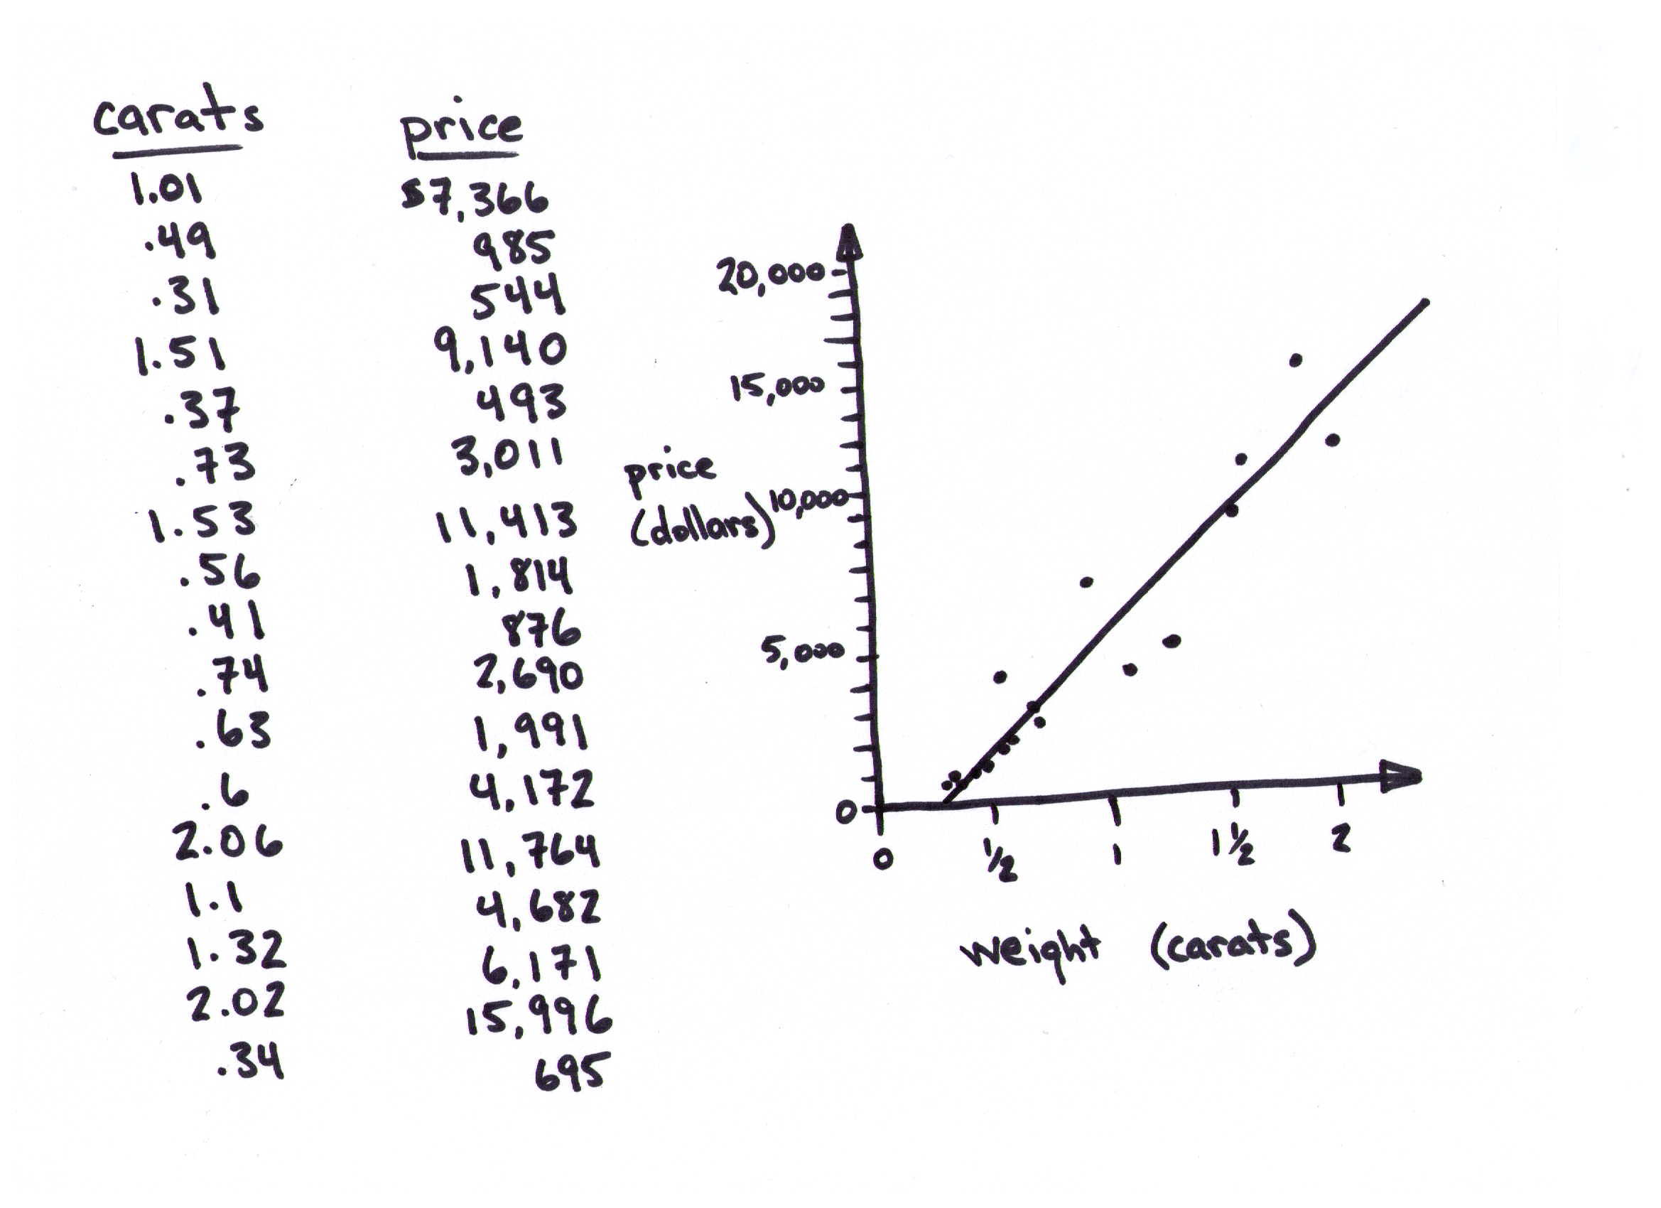
Diamonds
[modeling]
[linear regression]
[variance]
[noise]
Notes:
Raw values

Slide 51
Diamonds
Notes:
Raw values

Slide 52
Diamonds
[prediction]
Notes:
Raw values

Slide 53
Diamonds
Notes:
Raw values

Slide 54
Diamonds
[confidence
interval]
Notes:
Raw values

Slide 55
Congratulations!
We built a machine learning model.
We used linear regression.
We made a prediction, complete with a confidence interval.
(We didn’t need math or computers.)

Slide 56
There are lots of right ways to do it.

Slide 57
Cheat sheet

Slide 58
Cheat sheet

Slide 59
Cheat sheet

Slide 60
Cheat sheet

Slide 61
Cheat sheet

Slide 62
You can make other people do your work for you.

Slide 63
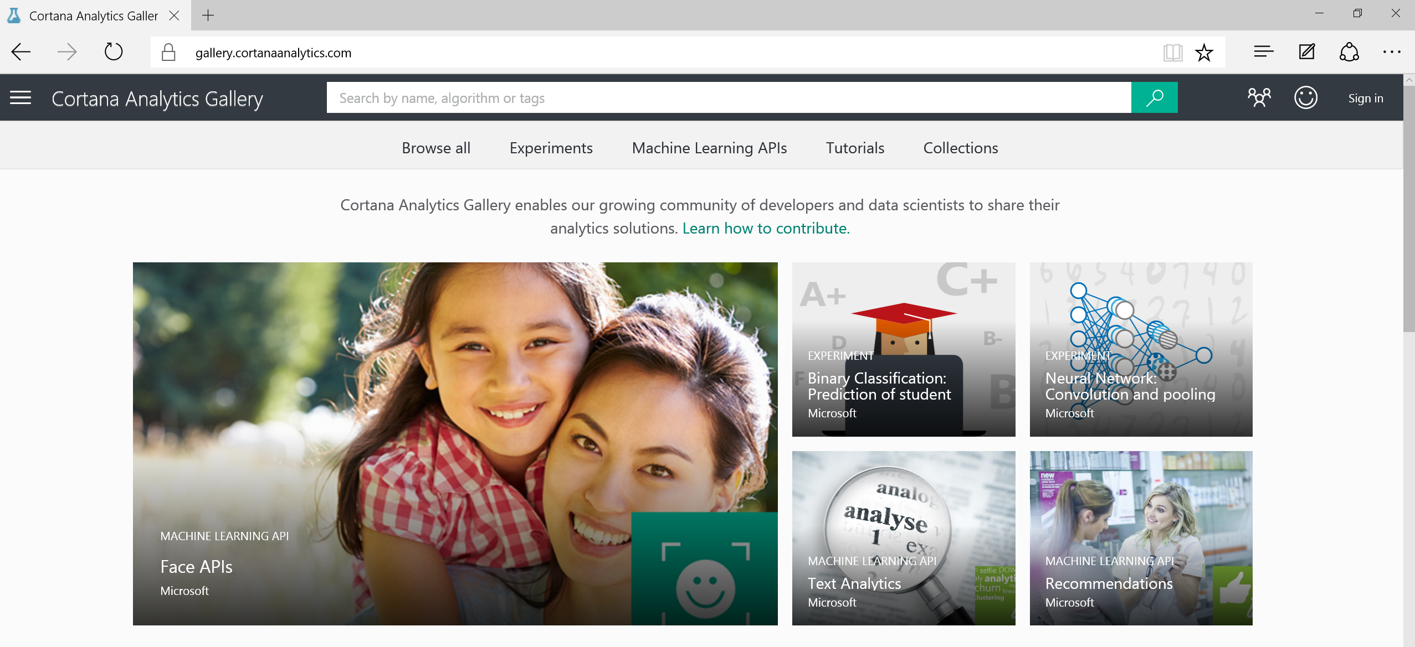
Gallery
Notes:
Add example of cutting and pasting from the Gallery

Slide 64
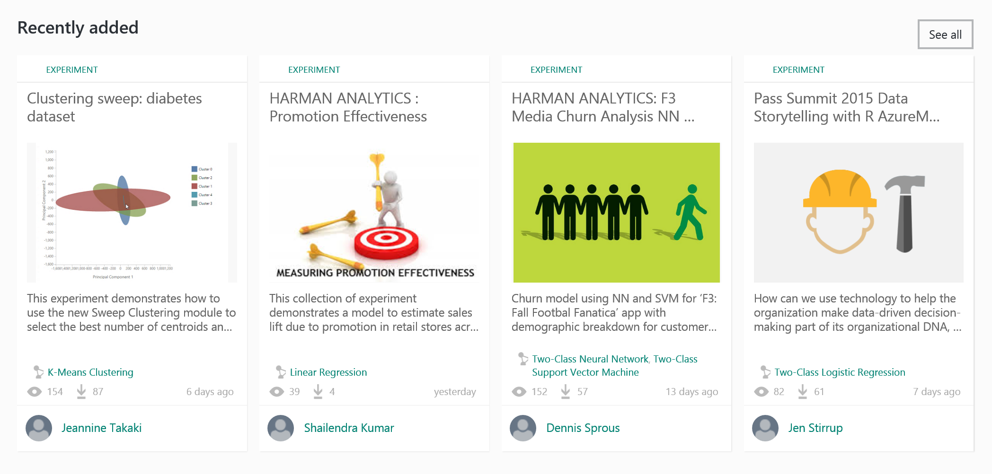

Slide 65
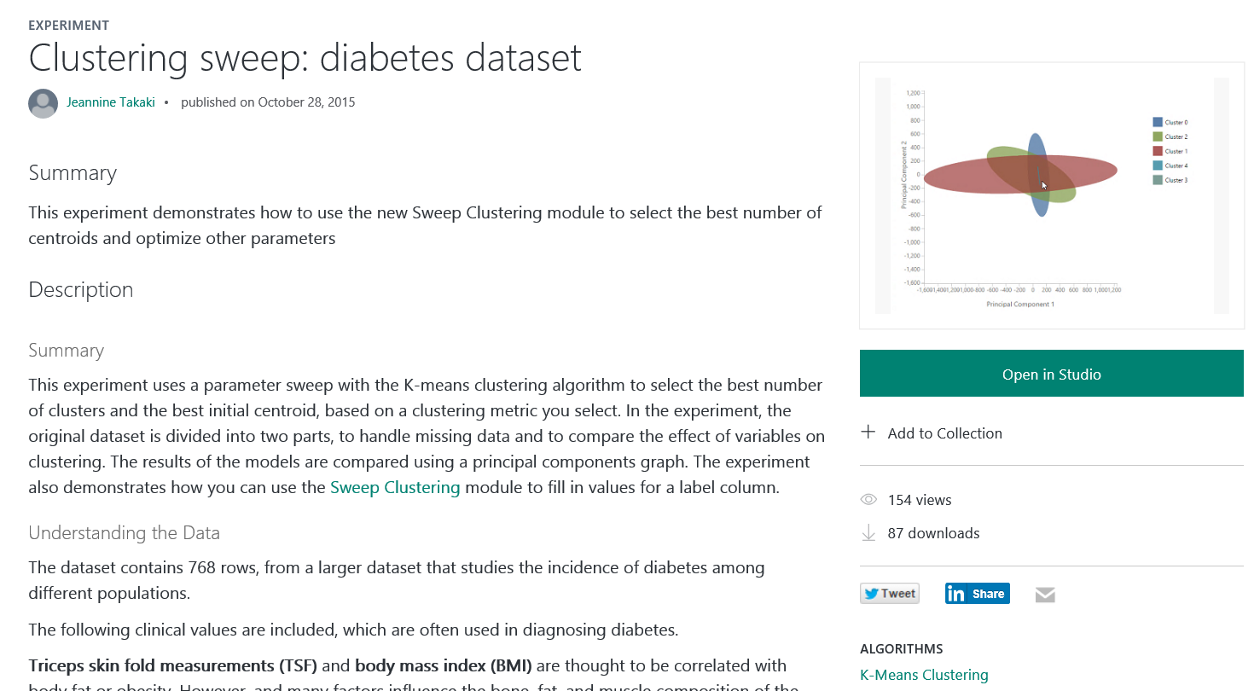

Slide 66
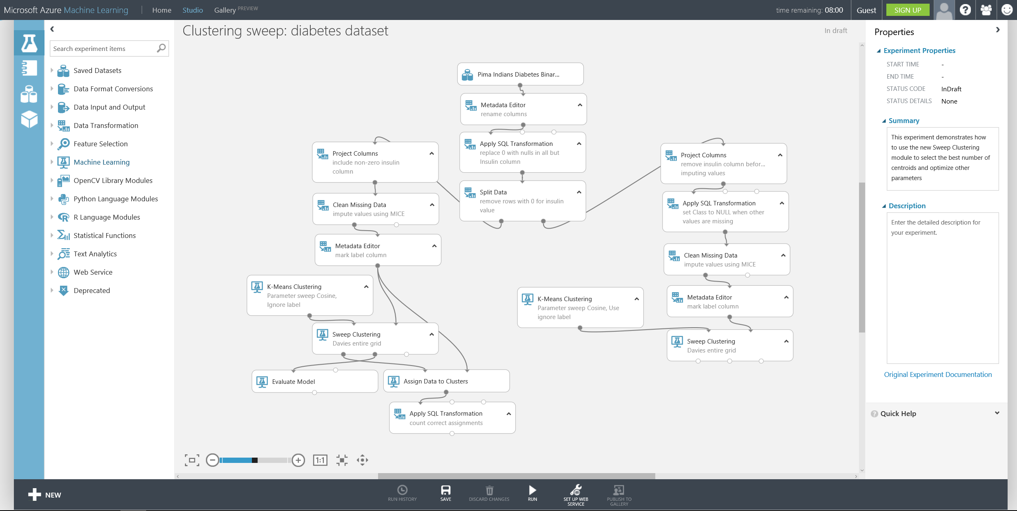

Slide 67
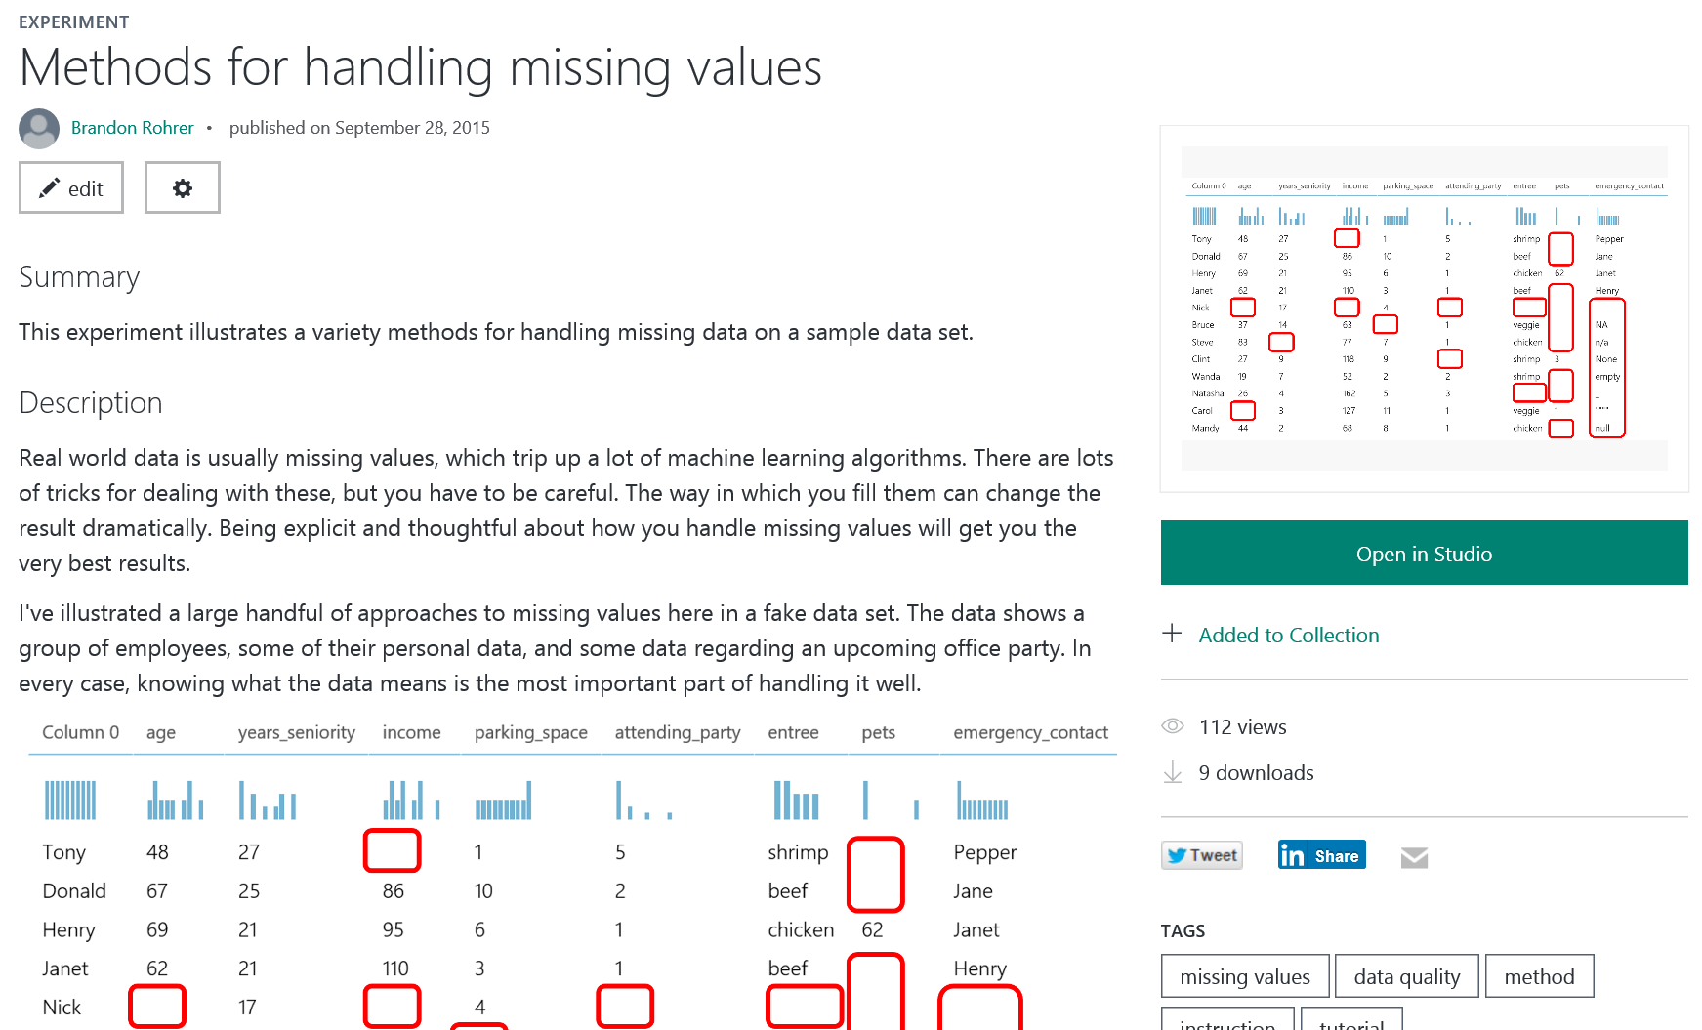

Slide 68
Secrets of data science revealed

Slide 69
Secrets of data science revealed
1. You can’t use just any data.

Slide 70
Secrets of data science revealed
1. You can’t use just any data.
2. Turn your data into a picture.

Slide 71
Secrets of data science revealed
1. You can’t use just any data.
2. Turn your data into a picture.
3. Data science can only answer five questions.

Slide 72
Secrets of data science revealed
1. You can’t use just any data.
2. Turn your data into a picture.
3. Data science can only answer five questions.
4. Machine learning is simple.

Slide 73
Secrets of data science revealed
1. You can’t use just any data.
2. Turn your data into a picture.
3. Data science can only answer five questions.
4. Machine learning is simple.
5. There are lots of right ways to do it.

Slide 74
Secrets of data science revealed
1. You can’t use just any data.
2. Turn your data into a picture.
3. Data science can only answer five questions.
4. Machine learning is simple.
5. There are lots of right ways to do it.
6. You can make other people do your work for you.

Slide 75
Resources
1. You can’t use just any data. | http://blogs.technet.com/b/machinelearning/archive/2015/08/26/what-can-data-science-do-for-me.aspx
2. Turn your data into a picture. | https://gallery.cortanaanalytics.com/Experiment/Data-exploration-through-visualization-1
3. Data science can only answer five questions. | http://blogs.technet.com/b/machinelearning/archive/2015/08/27/what-types-of-questions-can-data-science-answer.aspx http://blogs.technet.com/b/machinelearning/archive/2015/09/01/which-algorithm-family-can-answer-my-question.aspx
4. Machine learning is simple. | Unfortunately, you will have to learn math and a computer language to do this one.
5. There are lots of right ways to do it. | https://azure.microsoft.com/en-us/documentation/articles/machine-learning-algorithm-cheat-sheet/ https://azure.microsoft.com/en-us/documentation/articles/machine-learning-algorithm-choice/
6. You can make other people do your work for you. | https://gallery.cortanaanalytics.com/

Slide 76

Thanks for listening!
Thoughts to share? Questions?
Connect with me offline:
Brandon Rohrer on LinkedIn
@_brohrer_ on Twitter
brohrer@microsoft.com
Special thanks to Diane Rohrer for image and layout design.

